Slide 1



II
Coba bayangkan jika kita memiliki buku dengan halaman yang
tak terhingga
3
PRODUCT INTRIODUCTION
Apakah mungkin?

Slide 2

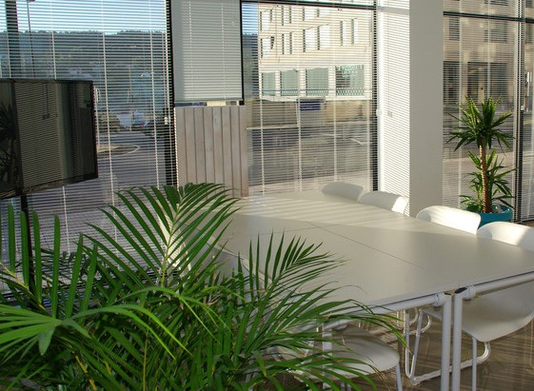


1. Pencemaran Lingkungan
Penggunaan kertas secara terus menerus akan merusak ekosistem lingkungan juga pencemaran lingkungan
Ruang Kerja Bersama Hara Laksana • 2020
2. Distraksi Media Sosial
Media digital seperti Smartphone, laptop, dan Ipad masih memicu distraksi tinggi bagi user
terutama pada penggunaan media sosial
Problem
3. Harga ATK Mahal
Harga ATK yang digunakan sebagai sarana
pendidikan cenderung mahal jika dihitung dalam pembelian beberapa tahun.

Slide 3


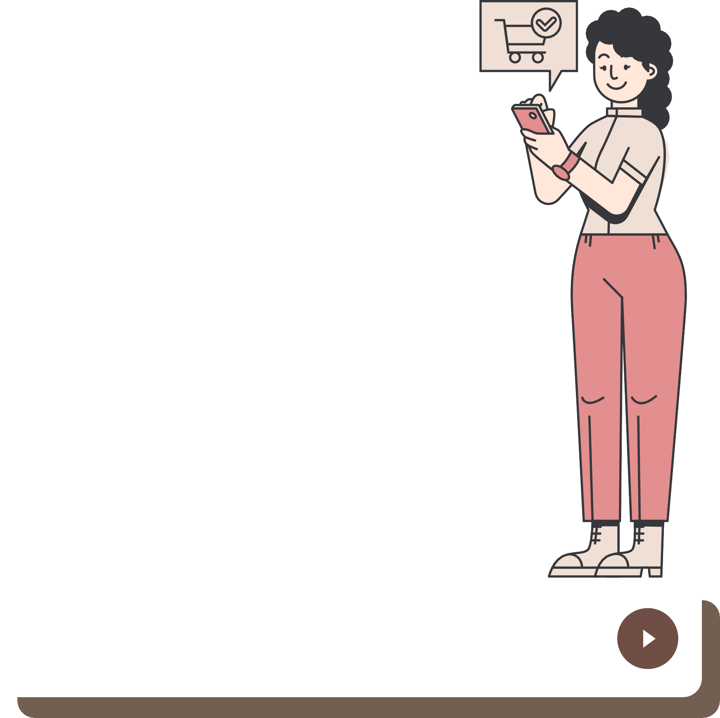






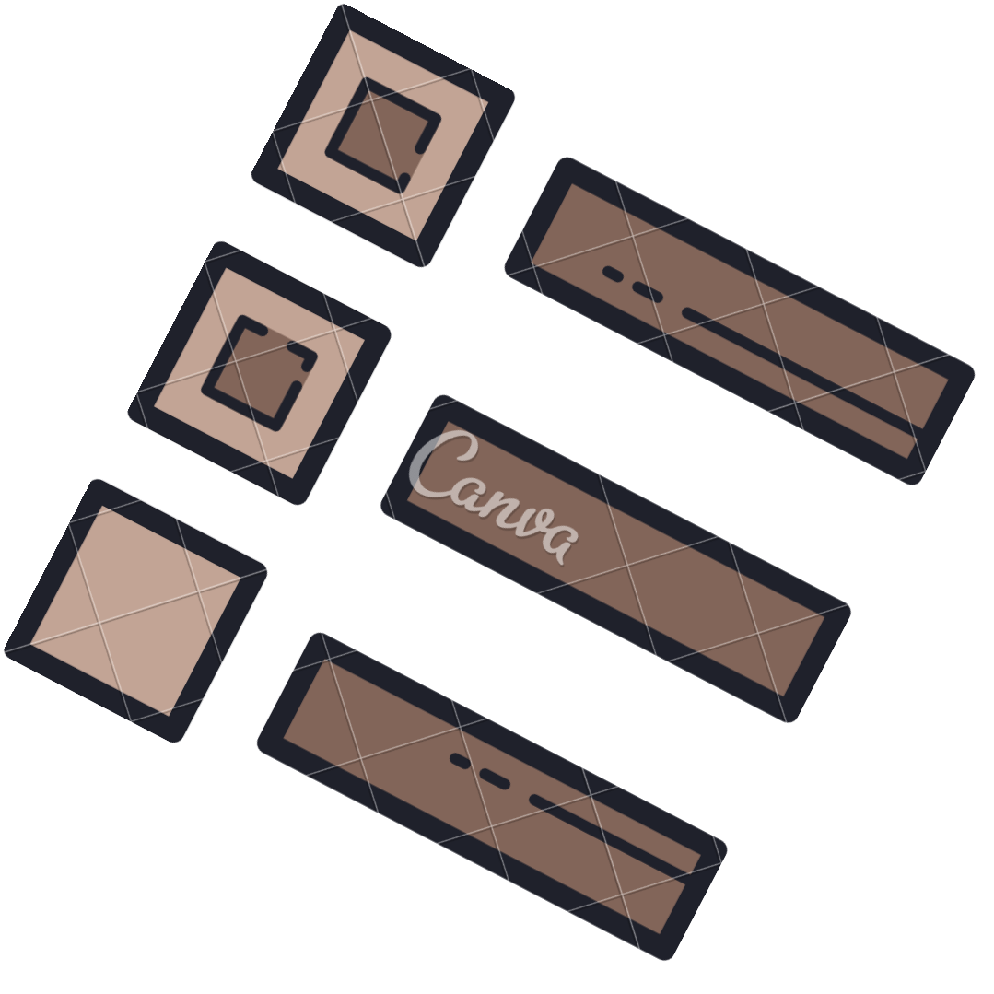



Whatis POY?
Poy
An innovation in the form of a
smartbook.
Khusus digunakan untuk edukasi sehingga user tidak terdistraksi. Produk inovatif ini dapat
memberikan manfaat bagi umat manusia dan berdampak positif bagi bumi.
Memudahkan pengguna sebagai alat tulis dengan fitur-fitur yang lengkap.

Slide 4

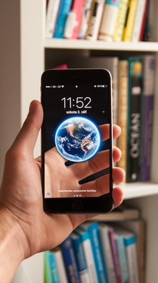

Solution #1
Poy digunakan sebagai pengganti Buku Tulis, Buku Cetak, dan Alat Tulis yang memerlukan kertas dan bahan lain yang dapat mencemari lingkungan.
Solution #2
Poy membatasi aplikasi yang dapat digunakan agar dapat membantu pengguna untuk fokus dalam pembelajaran mereka.
Solution #3
Poy tidak memerlukan pembelian alat yang terus-menerus seperti alat tulis biasanya.

Slide 5




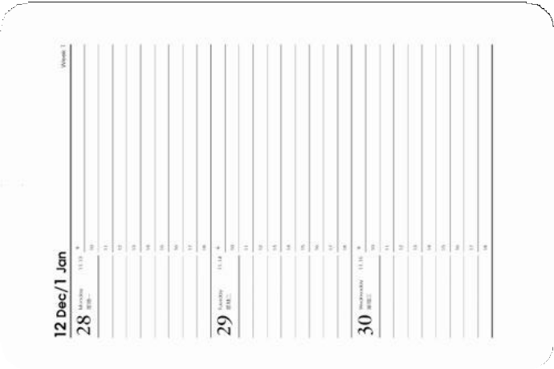



Prototype
IV
Bagian :
Visualisasi Produk
POY

Slide 6




Market Size
Populasi Tangerang 3.909 juta (Tahun 2020)
Sesuai dengantarget pasar Poy Smartbook
1.956.988 Jiwa

Slide 7
The Business Model Canvas
Key Activities Value Proposition
Customer Relationships
Customer Segments
Key Partners
Designing, manufacturing and delivering a product of superior quality, Consumer needs research, technology research and development,
Website development,
Service Features, Finding new solutions to individual problems faced by customers,
Online and Offline Marketing,
Creating and maintaining platforms,
Maintaining relationships
with customers, Evaluation and business
/brand development
opportunities.
Government Partnership : Customer,
Team Sponsors, Investors
Advertising : TV-Production and Online Platforms
Deforestation Go Green Convenience Customization
Savings on education costs Learning become more effective
Long usage time (Power can last up to 36 hours) Affordable price Advanced features Practically carried and used anywhere large storage
Paperless
Simple Way to Use Using a digital pen
Age : 12-45
Help Customer Directly Automated and Self-service Co-creation
Communities
Social Media Pages Review, Ratings, Feedback (Participation)
Profession : Students and Teacher
Demography : Man and Woman
Key Resources Industry Knowledge Human : Team R&D Software Engineer
Business Management Executives
Employees Financial : Cash Intellectual : Brand,
Patents, & Copyright
Geography : Domiciled in Indonesia
Channels
Offline Media Online Media : Official website
Social media Platforms
Psychography : Quality Oriented Service Oriented Usage Oriented Benefit Oriented
Cost Structure
Revenue Streams
Value Oriented Practicality Oriented
Marketing Cost Labor Cost (Salary)
Production / Operation Cost Offices
Software Engineering
Licensing fees Copyrights Legal
Sponsoring Advertising Merchandizing Partnership
Premium Users which receive more perks
Sales Subscription fee
Privilege Oriented
Social Status : Middle to Upper

Slide 8

Budget Plan
HARGA BAHAN
Processor
Rp. 552.500,-
Memory Chips
Rp. 33.900,-
Battery
Rp. 65.000,-
Graphic Processor
Rp. 550.000,-
Sound Processor + Speaker
Rp. 85.500,-
Sensors
Rp. 30.600,-
GPS Reciever + Wi-Fi antenna
Rp. 100.000,-
Bluetooth Chip
Rp. 22.750,-
FM Tuner
Rp. 50.000,-
Camera
Rp. 109.000,-
Stylus (Pen)
Rp. 52.000,-
TOTAL HARGA
Rp. 1.651.250,-

Slide 9


Timeline
Design & Development
Maret
Testing
Juni
Field Field Trial
Oktober
Maintenance
Februari '23
April
Prototyping
September
Certification
November
Production

Slide 10
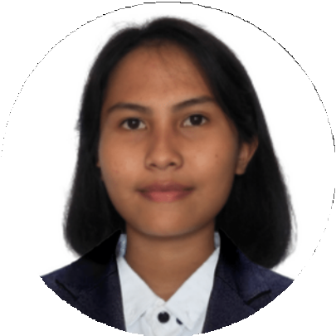



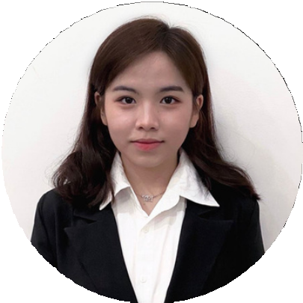

Team
Putu Ketri Handayani
Chief Executive Officer
Felix Tanoto
Chief Finance Officer
Jaqueline Aurelia Langi
Chief Business Development Officer
Adnan Fans H
Chief Technical Officer

